Slide 1
Credit Card Approval Prediction
Batch - 8
Guide: Dr.J.Hyma
Rakesh Naidu | 121810305023
Mani Chandra | 121810305032
Shashidhar | 121810305043
Vishnu | 121810305008

Slide 2
Abstract
Credit Card Approval Prediction is a machine learning solution to automate the process of credit card approval to an account. The model is trained with multiple attributes and the accuracy is measured with both train and test data.

Slide 3
Introduction
The accurate assessment of consumer credit risk is of uttermost importance for lending organizations. Credit scoring is a widely used technique that helps financial institutions evaluates the likelihood for a credit applicant to default on the financial obligation and decide whether to grant credit or not.

Slide 4
Introduction
The goal here is to build an end to end automated Machine Learning solution where a user will be able to predict whether a bank customer should be approved for attaining the credit card or not. The user is only need to give the value of feature variables and the model will able to predict the binary outcome (Approve/ Not Approve).

Slide 5
Introduction
The model will be able take care of all intermediate functionalities like cross validation, hyper parameter tuning, algorithm selection etc.
This project shall be delivered in two phases:
Phase 1: All the functionalities with PyPi packages. Phase 2: Integration of UI to all the functionalities.
Note: All the code will be written in python version 3.6

Slide 6
About Dataset
This file concerns credit card applications. All attribute names and values have been changed to meaningless symbols to protect confidentiality of the data.
This dataset is interesting because there is a good mix of attributes -- continuous, nominal with small numbers of values, and nominal with larger numbers of values. There are also a few missing values.
Data Source: UCI, Kaggle

Slide 7
Attribute Information
A1 | b, a | Gender
A2 | continuous | Age
A3 | continuous | Debt
A4 | u, y, l, t | Marital status
A5 | g, p, gg | Bank
A6 | c, d, cc, i, j, k, m, r, q, w, x, e, aa, ff | Education Level
A7 | v, h, bb, j, n, z, dd, ff, o | Ethnicity
A8 | continuous | Years Employed

Slide 8
Attribute Information
A9 | t, f | Prior default
A10 | t, f | Employed
A11 | continuous | Credit score
A12 | t, f | Drivers license
A13 | g, p, s | Citizen
A14 | continuous | Zip Code
A15 | continuous | Income
A16 | +,- (class attribute) | Approved

Slide 9
Existing Project
The Existing project is done with some data cleaning and then training and prediction which led to lower accuracy. Machine learning models used in the existing project are:
Logistic Regression
Decision Tree
Random Forest

Slide 10
Proposed Project
The proposed project is built end to end. Starting from Data Preprocessing to Deployment. This project includes the features like:
Statistical analysis
Hyper parameter tuning
Best algorithm selection
Deployment in Heroku using flask.

Slide 11
Limitations of the existing project.
Some of the areas where the existing project is lacking are:
High accuracy
Data analysis
Training with more models
Different model selection criteria
Deployment

Slide 12
Objectives of proposed project
The main objectives of the proposed project are to:
Increase the accuracy
Do Exploratory data analysis
Test the model with different algorithms
Try different model selection criteria
Do Hyperparameter tuning
Deploy the project for easy use

Slide 13
System requirements
For Model Training | For Model Testing
8 GB RAM | 4 GB RAM
2 GB of Hard Disk Space | 2 GB of Hard Disk Space
Intel Core i5 Processor | Intel Core i5 Processor
Note: These are just Recommended.

Slide 14
Algorithms to be used in the project
Different Machine Learning algorithms used in the project are:
Decision Tree
Random Forest
XG Boost
KNN Classifier
Naïve Baye’s

Slide 15
Technologies to be used in the project
Different technologies or libraries used in the project are:
numpy, pandas
matplotlib, seaborn
scipy, scikit learn
xgboost
html, css
flask, gunicorn

Slide 16
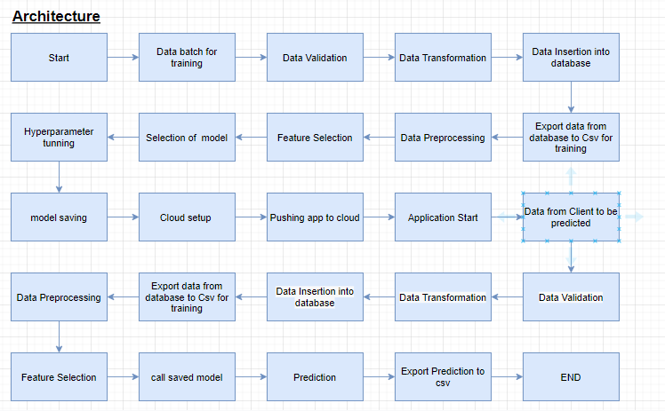
Flow Chart of the proposed project

Slide 17
References
https://www.ijrar.org/papers/IJRAR190B030.pdf
https://www.ijeat.org/wp-content/uploads/papers/v9i4/D7293049420.pdf
https://www.researchgate.net/publication/321002603_Credit_Approval_Analysis_using_R
https://rstudio-pubs-static.s3.amazonaws.com/73039_9946de135c0a49daa7a0a9eda4a67a72.html

Slide 18
Thank You

